Slide 1
ABDUS and phased array antennas
Phased arrays consist of closely distributed antenna elements, allowing synthesis of multiple independent beams.
ABDUS proposes the use of phased arrays to boost BINGO's capabilities.
ABDUS-1 involves associating phased arrays with the BINGO focal plane using Vivaldi antennas and beamformers.
ABDUS-2 includes outriggers composed of feed horns and phased-array stations 20 km away to achieve higher angular resolution.

Slide 2
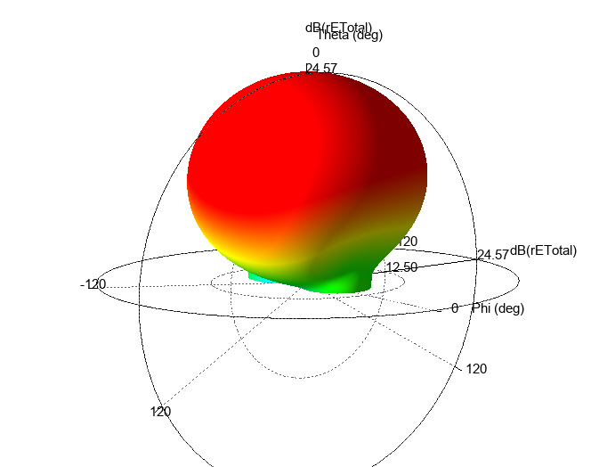
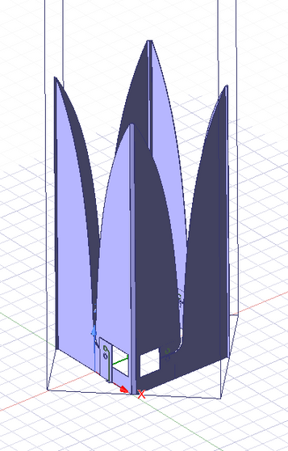
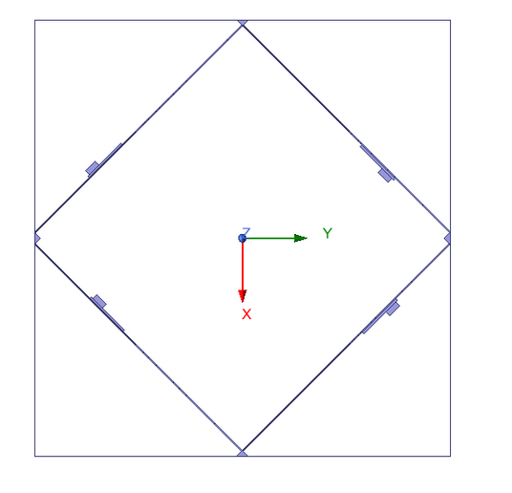
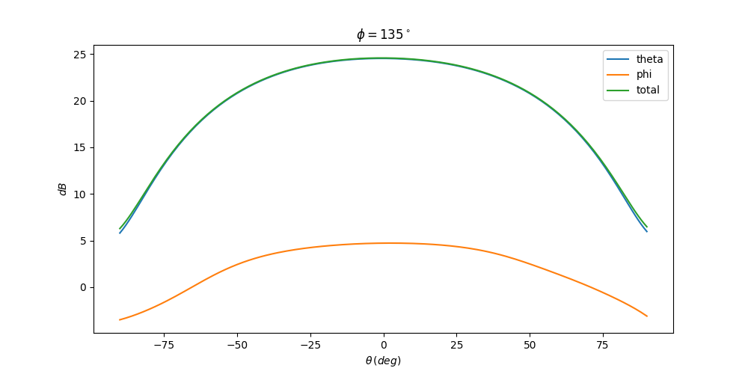
Unit Cell simulation
One unit cell is assumed with four antenna elements, two for each polarization.
We excite two elements of same polarization and run EM simulations on HFSS sofware.

Slide 3
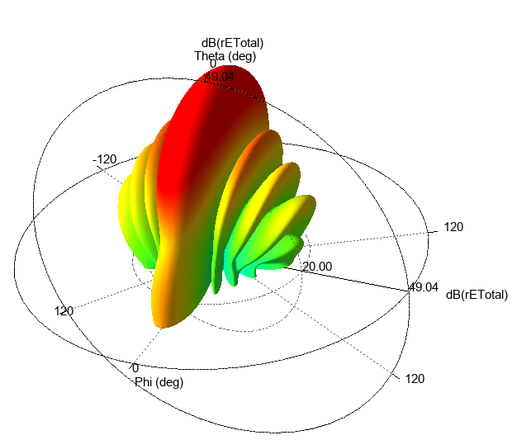
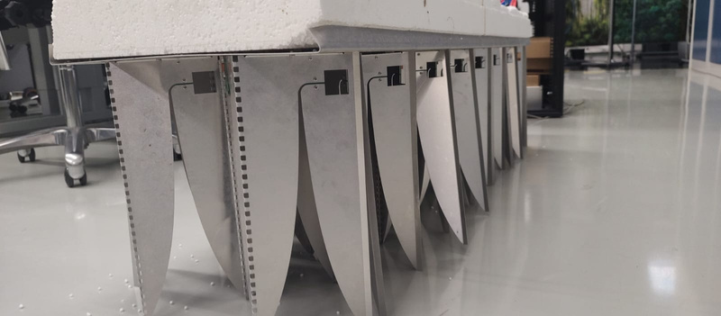
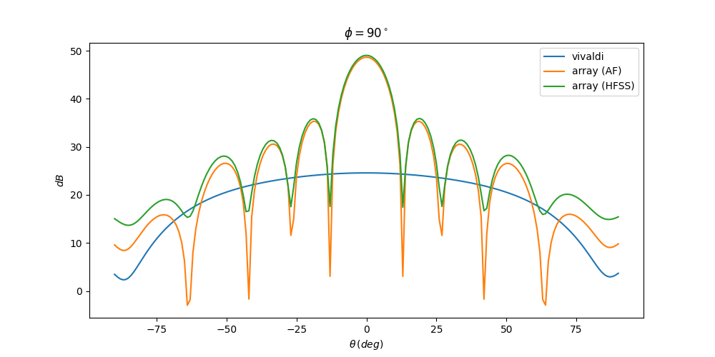
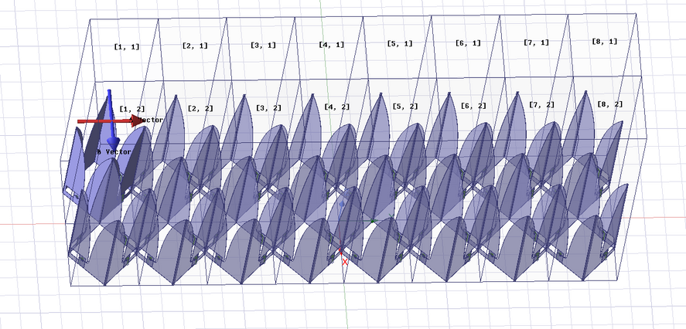
Vivaldi Tile simulation
We simulated a 2x8 array. It correspond to a 35cm x 134 cm tile that will be used on ABDUS project.
The tile is also under tests on ASTRON facilities and will be sent to Brazil after some measurements be finished.

Slide 4
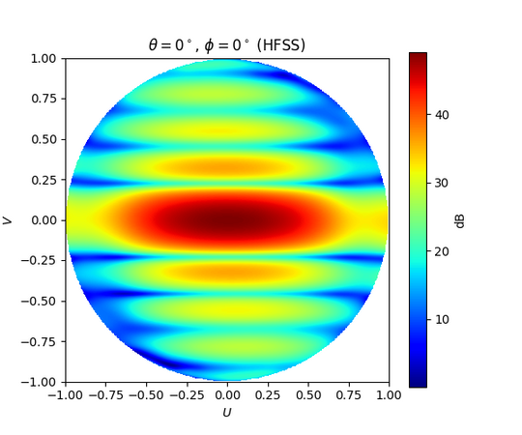
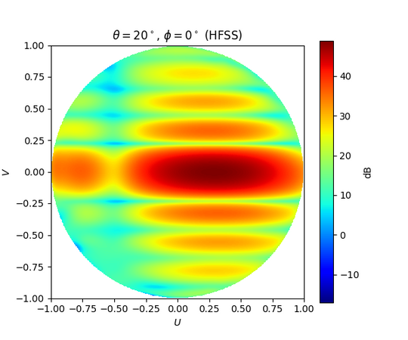
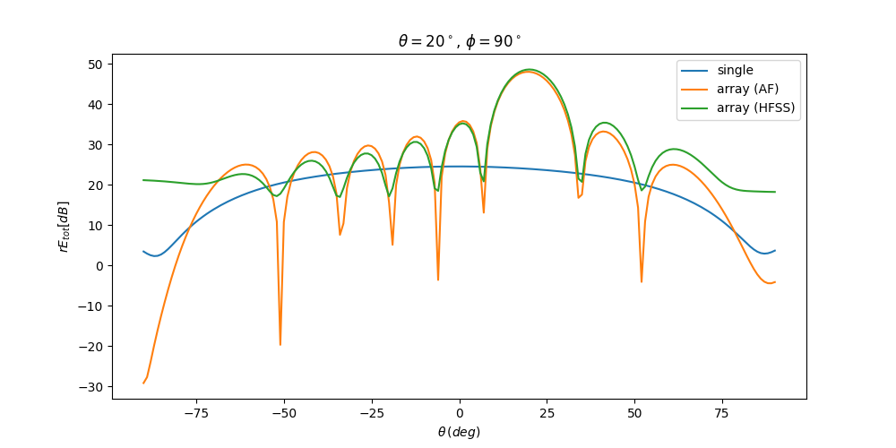
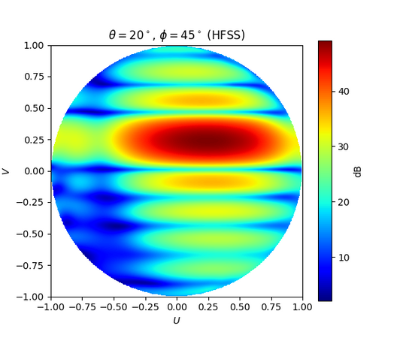
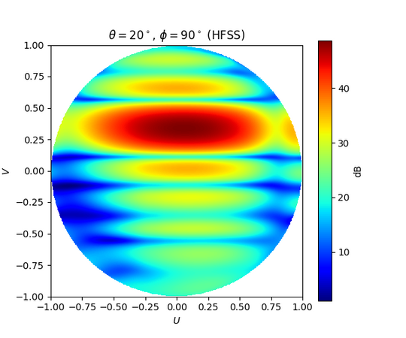
Vivaldi Tile simulation: scanning
The array can be be electronically steered to point in different directions without moving the antennas.
We then present simulations steering in some different directions.

